Slide 1
Govt.digvijay. Autonomous.pg.college.rajnandgaon
Seminar presentation
On
Downy Mildews , Powdery Mildews
Session-2020
Guided by- presented by
Dr. Kiran Jain Mam Okeshwer Kumar Sahu
Department of botany M.Sc. forth semester

Slide 2
SYNOPSIS :-
INTRODUCTION
DEFINITION
HISTORY
POWDERY MILDEWS:- 1. INTRODUCTION
2. PATHOGEN
3. SYMPTOMS
4.DISEASE CYCLE
5 .MANAGEMENT
DOWNY MILDEWS:- 1. INTRODUCTION
2. PATHOGEN
3.SYMPTOMS
4.DISEASE CYCLE
5. MANAGEMENT
CONCLUSION
REFERENCE

Slide 3
INTRODUCTION :-
Phytopathology (phytons – plant ,pathos- suffering, logos- knowledge) is the study of the diseases of plants and covers the entire field of biological and scientific activity concerned with the understanding of this complex phenomenon . phytopathology is thus the study of the nature , development ,and control of plant diseases.
Organisms that cause infectious disease include fungi, bacteria ,viruses , viroid's ,virus like organisms ,phytoplasmas , protozoa, nematodes and parasitic plants diseases.

Slide 4
DEFINITION:-
“Plant pathology is that branch of agricultural , botanical or biological science which deals with the study or the causes , etiology resulting losses and control measures of plant diseases”.

Slide 5
POWDERY MILDEWS:-
Powdery mildew was first reported by Butler in 1907 at Chenab canal of Punjab .
Powdery mildews is caused by Erysiphe cruciferarum.
The name E. cruciferarum was given by Junell in 1967.

Slide 6
POWDERY MILDEWS IN VARIOUS PLANT AND THEIR PATHOGENS:-
Disease Name | Plant Name (Host) | Pathogen
Powdery mildews | Peas | Eryshipae polygoni
Powdery mildews | Grapevine | Uncinula necator
Powdery mildews | Apple | Podosphaera leucoteicha
Powdery mildews | Mango | Oidium mangiferae
Powdery mildews | Cucurbits | Erysiphae cichoracearum

Slide 8
PATHOGEN OF SYSTEMATIC POSITION:-
KINGDOM – MYCOTA
DIVISION- EUMYCOTA
CLASS- LEOTIOMYCETESS
ORDER- ERYSIPHALES
FAMILY- ERYSIPHACEAE
GENUS- Erysiphe
SPECIES- poligoni

Slide 9
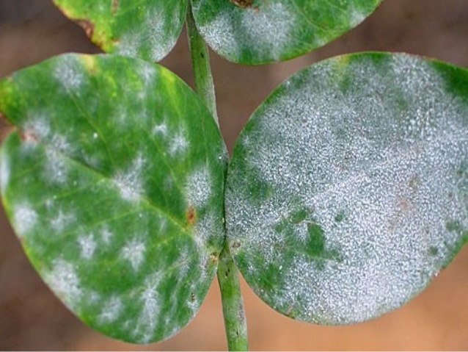
POWDERY MILDEWS OF PEA:-
SYMPTOMS :-
Symptoms appear in dry season .
Firstly on old leaves and then others pats .
Formation of powder on both surface of leaf.
Later formation of powdery spots on tendrilis , pod etc.
White powder on plant surface .
Increase respiration and transpiration .
Decrease photosynthesis .
Spots on pod surface – grain small and shrinked –loss in yield .
FIG:- SYMPTOMS SHOWING OF POWDERY MILDEWS DISEASE

Slide 10
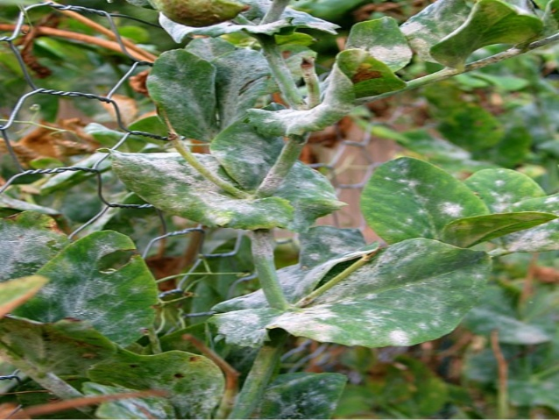
FIG :-POWDERY MIDEWS OF PEA PLANT

Slide 11
FIG:- ERYSIPHAE POLYGONI HYPHAE AND HOST CELL

Slide 12
DISEASE CYCLE:-
FIG:- DISEASE CYCLE OF POWDERY MILDEWS

Slide 14
DOWNY MILDEW:-
Downy mildew are primary foliage blights. They attack and spread rapidly in young, tender green leaf twig , and fruit tissues .
They develop and are severe when a film of water is present on the plant tissues and the relative humidity in the air is hight during cool or warm ,but not periods . Downy mildews can severe losses in short periods of time.

Slide 15
DOWNY MILDEWS IN VARIOUS PLANT AND THEIR PATHOGEN:-
DISEASE NAME | PLANT NAME (Host ) | PATHOGEN
DOWNY MILDEWS | PEA | Peronospora pisi
DOWNY MILDEWS | RADISH | Peronospora parasitica
DOWNY MILDEWS | PARWAL | Plasmopara viticola
DOWNY MILDEWS | GRAPES | Sclerospora graminicola
DOWNY MILDEWS | BAJRA | Sclerospora graminicola
DOWNY MILDEWS | MAIZE | Pernosclerospora sorghi

Slide 16
DOWNY MILDEWS OF GRAPES SYMPTOMS:-
The pathogen attacks all green parts of the vine , especially the leave . Lesions on leave are angular , yellowish , sometimes only ,and located , between the veins . As the disease progresses , a white cottony growth can be observed on the lower leaf surface . Severely infected leaves will drop.

Slide 17
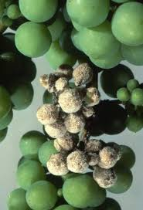
FIG:- SYMPTOMS OF DOWNY MILDEWS

Slide 18
FIG:- SPORANGIOPHORES AND SPORANGIA

Slide 19
DISEASE CYCLE OF DOWNY MILDEWS:-
FIG:- GRAPES IN DOWNY MILDEWS DISEASE CYCLE

Slide 20
PHATHOGEN OF SYSTEMATIC POSITION :-
KINGDOM – MYCOTA
DIVISION – EUMYCOTA
CLASS- OOMYCOTA
ORDER- PERONOSPORALES
FAMILY – PERONOSPORACEAE
GENUS- PLASMOPARA
SPECIES – viticola

Slide 21
MANAGEMENT OF DISEASE:-
The practice of fungicide rotation is extremely imporntant for managing downy mildew , since it is a hight –risk pathogen for the development of fungicide resistance .
Take care to use several classes of fungicides in a downy mildew chemical control program , to prevent fungicide resistance from occurring.

Slide 22
CONCLUSION
We are already known that fungus are the parasitic organism and caused the various types of disease on plant and all other living organisms.
There are also obligate and facultative fungi which is caused the disease in a specific host and any other alternative host, respectively.

Slide 23
REFERENCE :-
R.S. MEHROTRA AND ASHOK AGARWAL – PLANT PATHOLOGY ,TATA McGraw HILL EDUCATION PRIVATE LIMITED, SECOND EDITION.
B.P. SINGH – PLANT PATHOLOGY ,AMAN PUBLISHING HOUSE LIMITED, 2004

Slide 24
THANK YOU

